Slide 1

Image Encryption and Decryption
"Enhancing Cybersecurity through Cryptography"
NAME: UDAY KIRAN
SLASHMARK PROJECT BASIC

Slide 2
CONTENT
Introduction
Key Aspects of the Project
Project Scope
Screen shots of implemented work
Demonstration of the Project
Conclusion
References

Slide 3
Introduction
Encryption : It is nothing but a simple process in which we convert our data or information into secret code to prevent it from unauthorized access and keep it private and secure.
Decryption : It is nothing but a process of converting our encrypted data into a readable form. Here we will again apply the same XOR operation on an encrypted image to decrypt it. But always remember that our encryption key and decryption key must be the same.

Slide 4
Key Aspects of the Project
Enhanced Security: Elevating the security measures surrounding digital images to safeguard against potential breaches and malicious activities.
Cryptography Integration: Exploring and implementing cryptographic principles to establish a robust framework for image encryption and decryption.
Internet Accessibility: Meeting the unique challenge of securing images even when openly accessible over the internet, emphasizing the crucial role of encryption in an interconnected digital environment.

Slide 5
Project Scope
This project goes beyond traditional image protection methods by delving into advanced cryptographic algorithms and key management strategies. Our aim is not only to encrypt images but also to provide a secure means for authorized users to decrypt and access the original content.

Slide 6
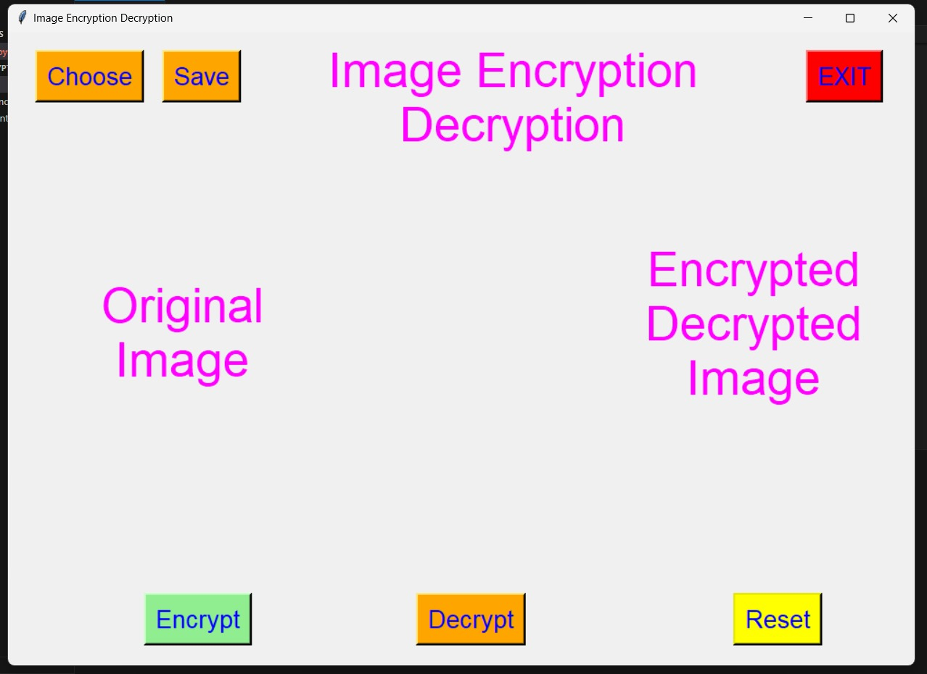
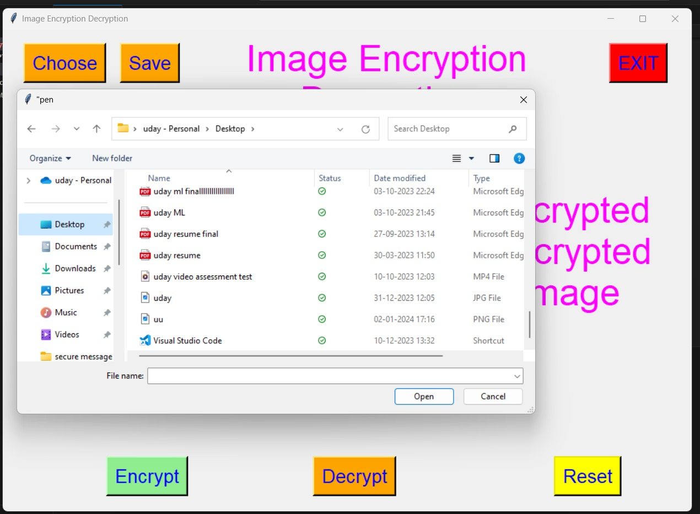
Screen shots of implemented work

Slide 7
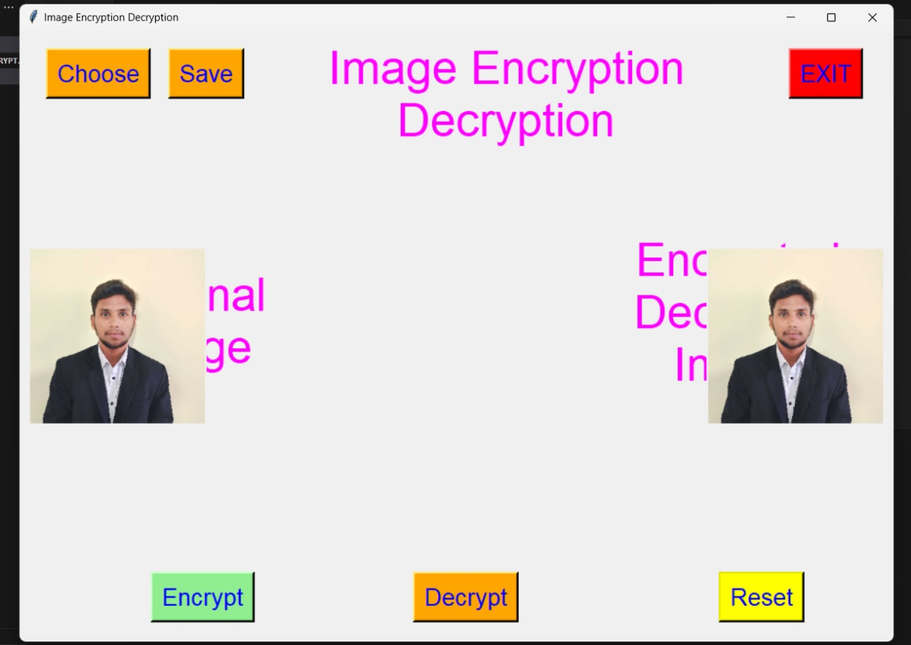
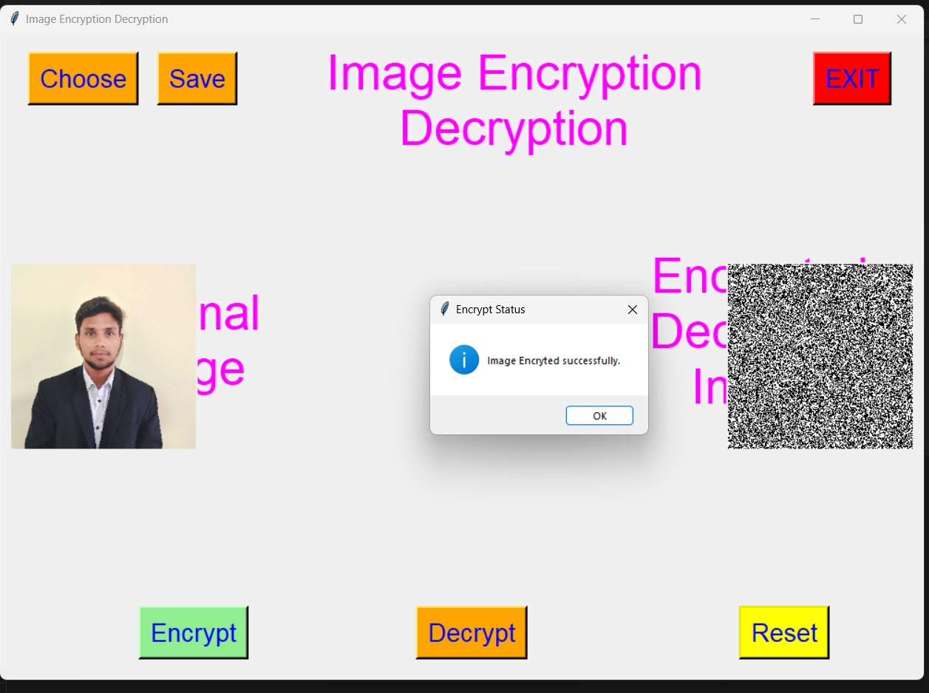

Slide 8
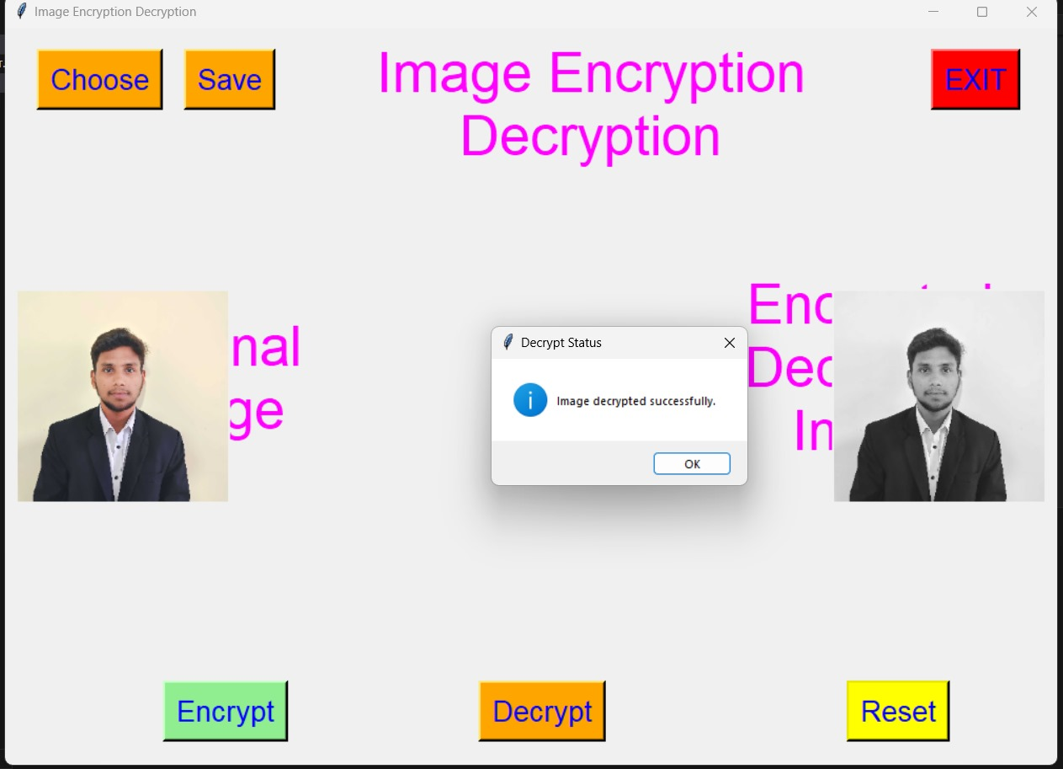
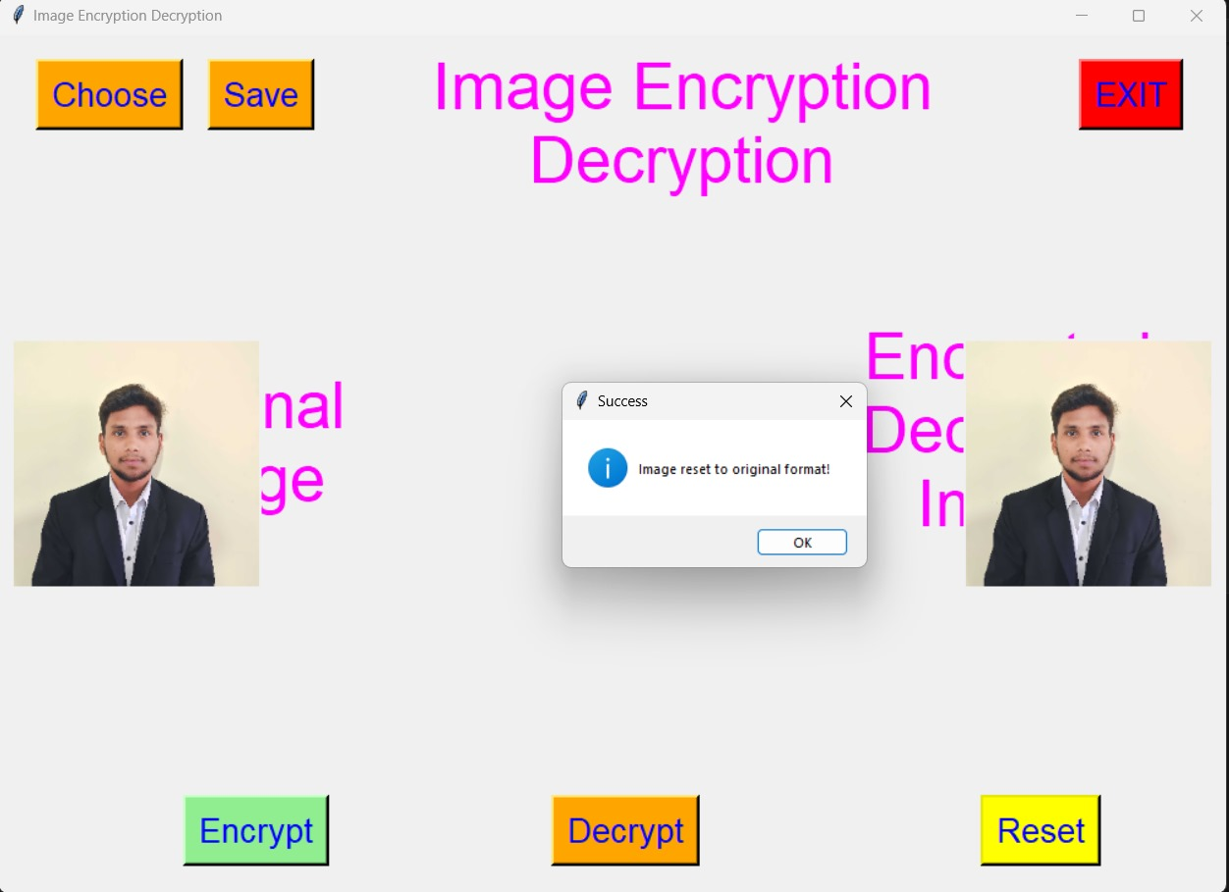

Slide 9
Conclusion
In conclusion, the "Image Encryption and Decryption Project" has been a journey into fortifying digital security, specifically focusing on the safeguarding of digital images. By implementing advanced encryption techniques and delving into the principles of cryptography, we've successfully developed a robust system that ensures the confidentiality and integrity of digital assets, even when accessed over the internet. Despite encountering challenges in key management and secure transmission, the project has thrived, providing valuable insights into enhancing cybersecurity. Looking forward, our efforts will continue to refine encryption algorithms, explore emerging cryptographic methodologies, and actively contribute to the evolving landscape of digital asset security. This project marks a significant step towards a future where our digital resources are resiliently protected in the face of evolving cyber threats.

Slide 10
References
Cryptography Basics:
"Cryptography and Network Security: Principles and Practice" by William Stallings.
Python Libraries for Image Processing:
OpenCV Documentation
Pillow (PIL Fork) Documentation
Image Encryption Algorithms:
"A Survey of Image Encryption Techniques" by Shorok A. Ali.
Key Management and Security:
"Public Key Cryptography" by Christof Paar and Jan Pelzl.
NIST Key Management Guidelines
GitHub Repositories for Image Encryption Projects:
Image Encryption using Python

Slide 11


